Slide 1
Lab 3- Python

Slide 2
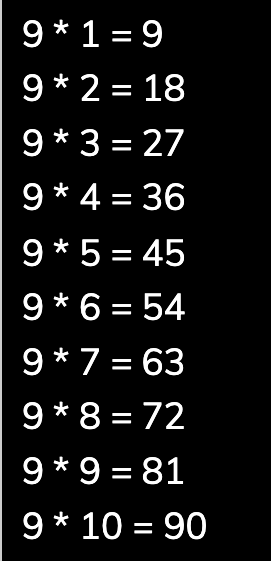
Lab 3- Python
Write a program to enter names of employees and their salaries as input and store them in a dictionary.
Name of the employee should be the key, the salary is the value
Use infinite while loop until the user enters ‘no’.
Write a program to find and display the largest number of a list without using built-in function max().
Your program should ask the user to input 10 values into the list then display the largest number .
Write a program that prompts the user to input a Celsius temperature and outputs the equivalent temperature in Fahrenheit.
The formula to convert the temperature is: F = 9/5 C + 32
where F is the Fahrenheit temperature and C is the Celsius temperature.
Write a program that prompts the user to input a number and prints its multiplication table.
Notes:
Aeiou AEIOU

Slide 3
Lab 3- Python
Suppose you have the following code:
Complete the code by writing a decorator that repeats the call of hello() as many as the entered number (x)
x= int(input("Enter a number of repetitions"))
# Write your decorator here
def hello():
print ('Hello')
hello()
Notes:
Aeiou AEIOU

